Slide 1
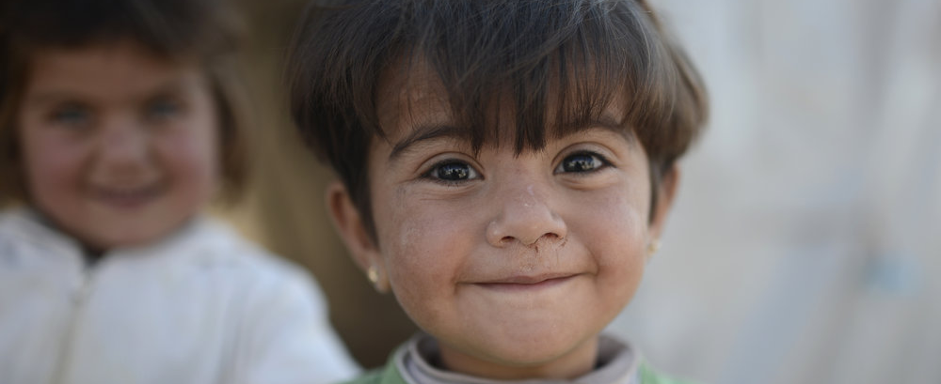


Developing a Mobile App for Build a Bridge Foundation
BAB Foundation
In collaboration with
September 27, 2018
Debanjan Paul
Prachi Patil

Slide 2
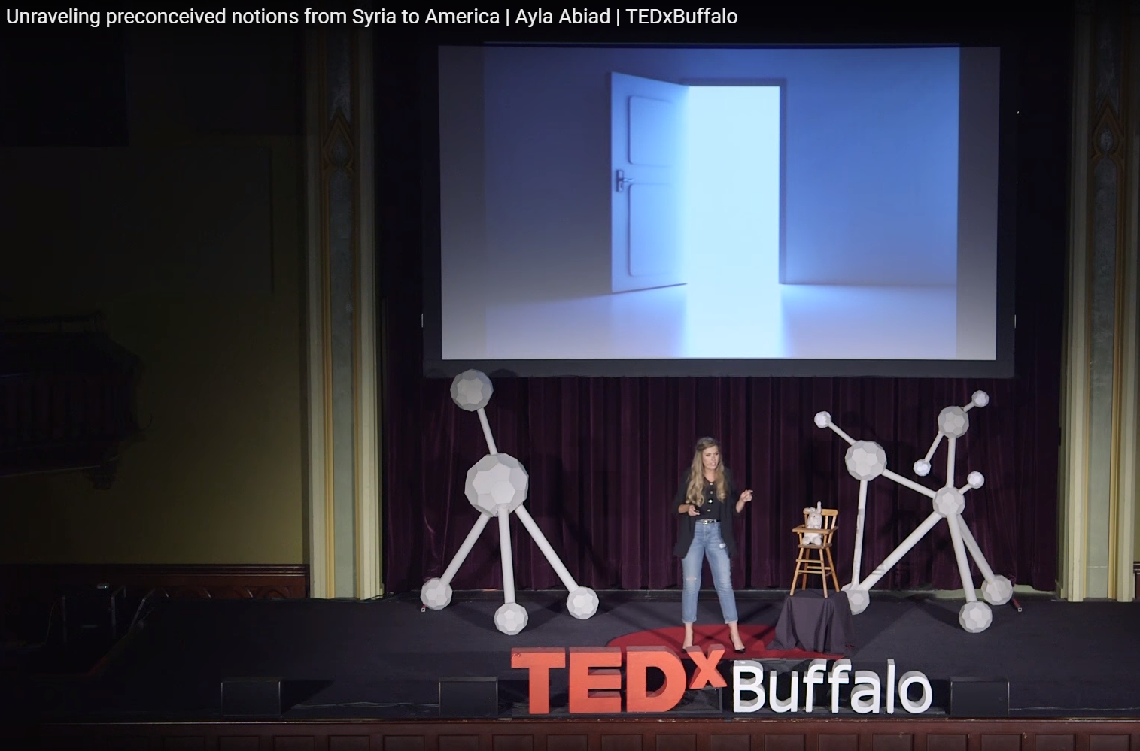
Ayla Abiad
MS Architecture, UB
BAB Founder
“So far, BAB volunteers have helped more than 55 families with transportation, translations, applying for jobs, schools and driver’s licenses, and other nuances of American culture. Abiad has also partnered with the UB School of Engineering and Applied Sciences to create a mobile app that will allow BAB to expand its work.”

Slide 3
Project Objective
Develop a BAB app for iOS and Android with accompanying web admin portal
Deliver an alpha-prototype to Ayla and her team by end of December

Slide 4
Targets
Basic functionality which is present on the website
Sign-Up
Make requests
Respond to requests
Region based grouping of Requests
Additional Functionality(Experimental - Beta)
Skills listing
In-app messaging
Administrative features

Slide 5
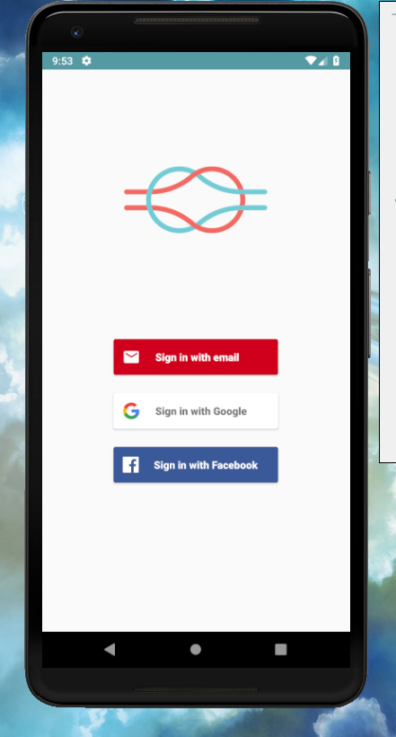
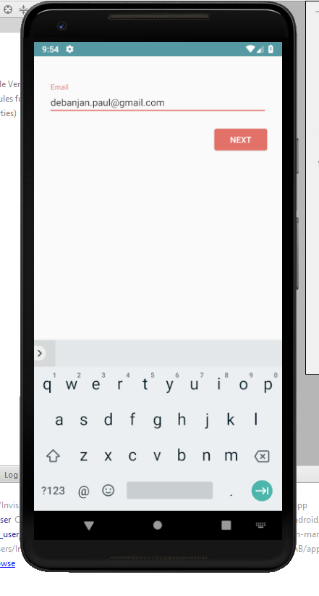
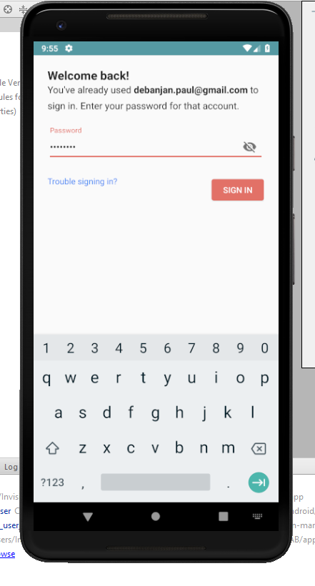
Sign-Up/Login
Authentication handled by Firebase
Facebook/Google login works for developers only, since app is in development mode
User duplication is prevented by Firebase on the background based on email.

Slide 6
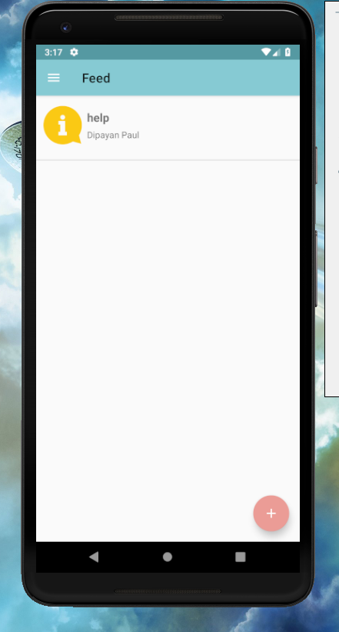
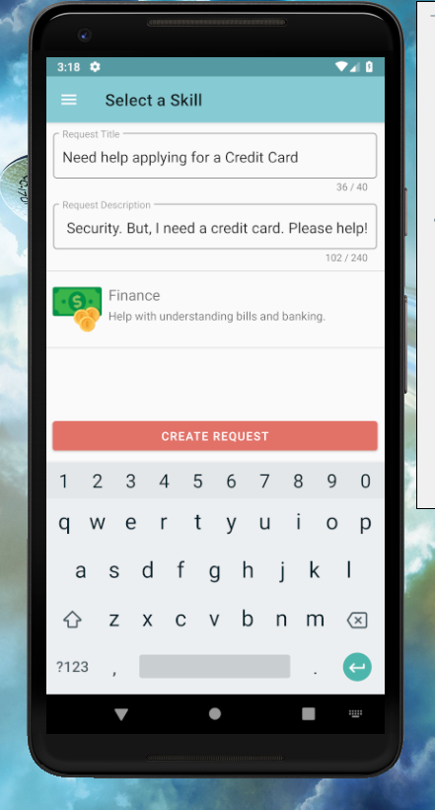
Feed - Homepage
View open requests within the region
Create new requests
Open requests – view details

Slide 7
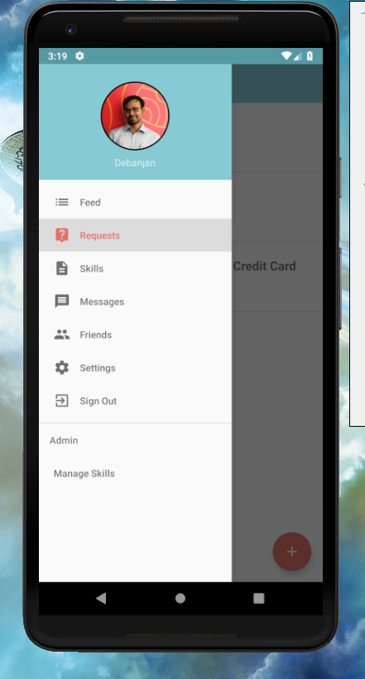
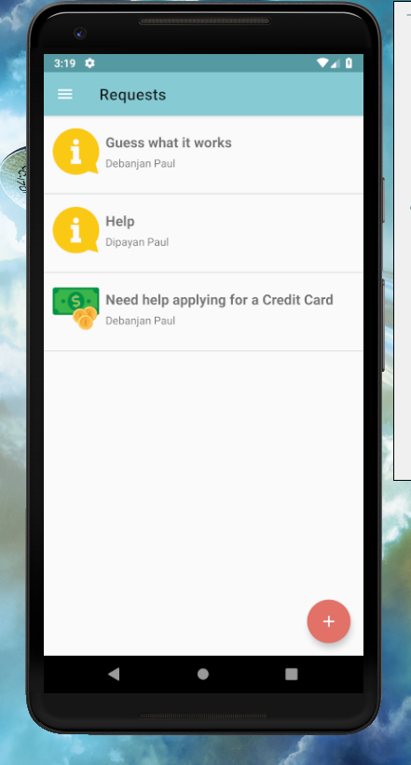
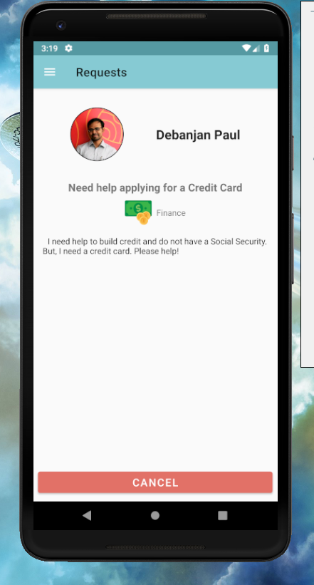
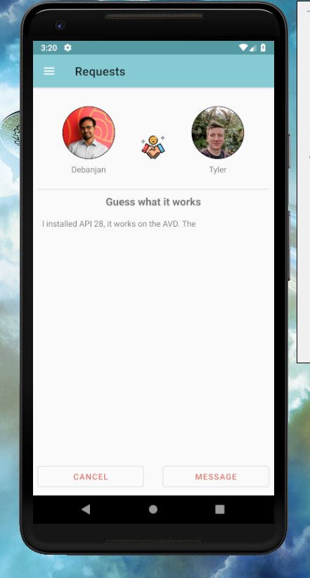
Requests History
View created requests
View responded requests
Check if anybody responded to requests made
Message responders directly*
Cancelling requests is not yet supported
Items marked with an * are experimental
Items marked in red are in development

Slide 8
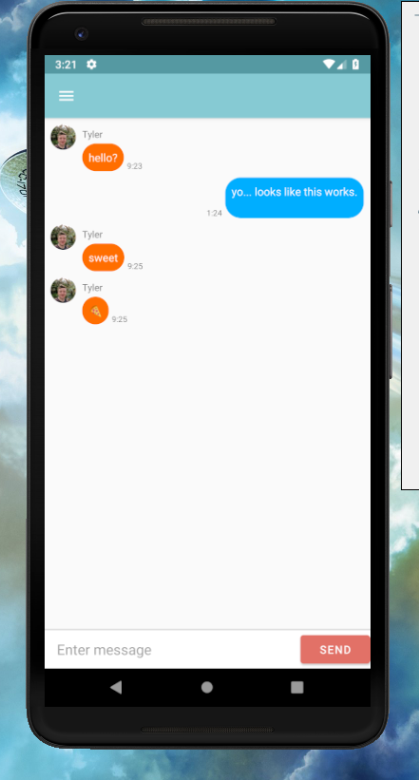
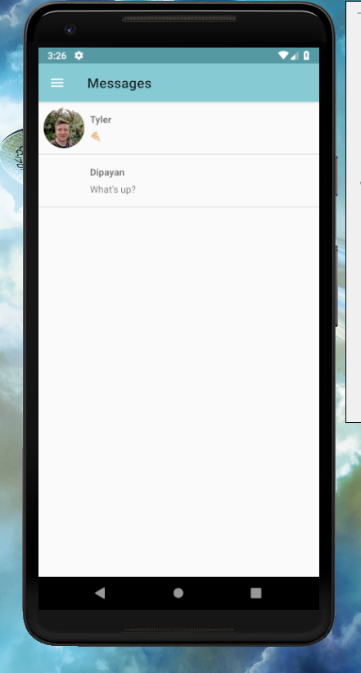
Messaging*
In-app messaging is supported to directly contact the responder
Message history supported

Slide 9
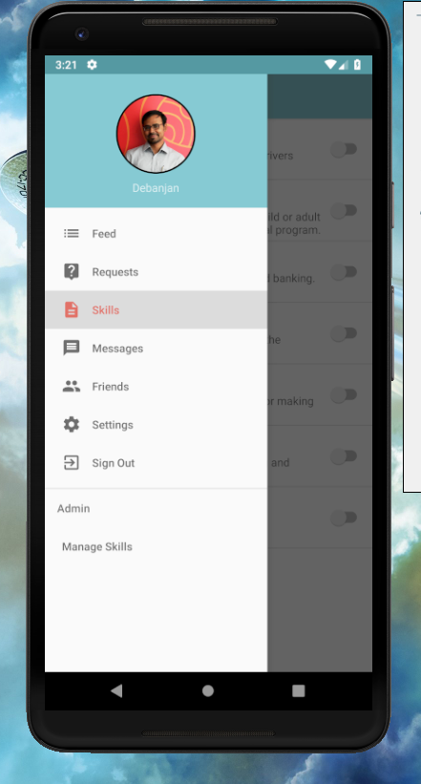
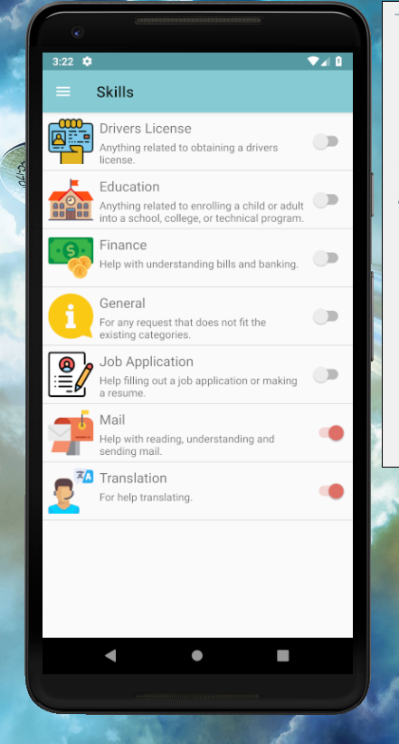
Skills Listing*
Adding skills is supported and users are tagged to such skills
Feed will be filtered based on skills
Items marked with an * are experimental
Items marked in red are in development

Slide 10

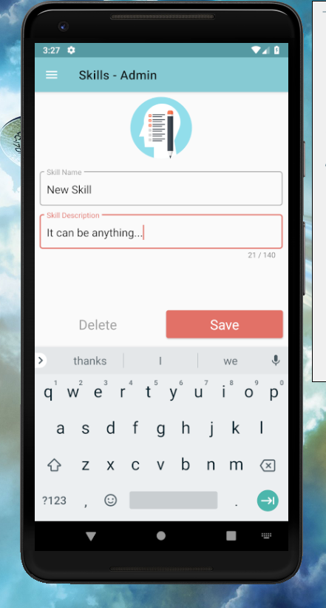
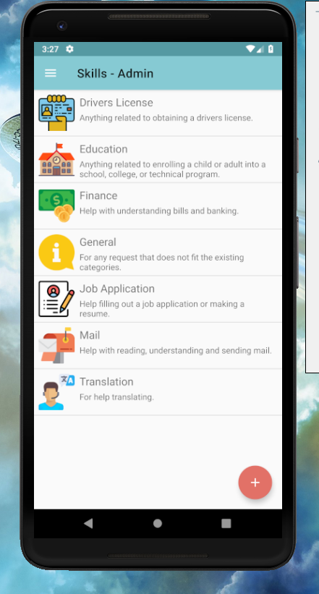
Admin tools*
Add new skills for volunteers to list
Deletion is supported
Items marked with an * are experimental
Items marked in red are in development

Slide 11
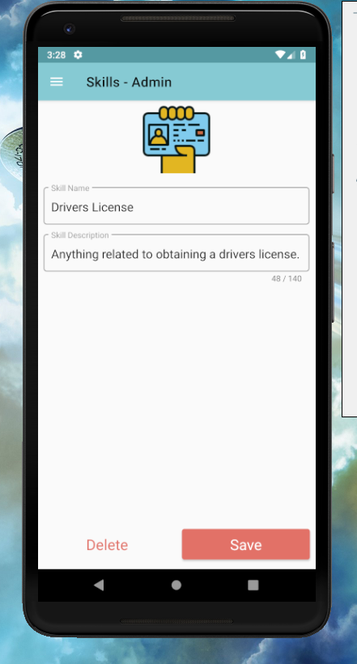
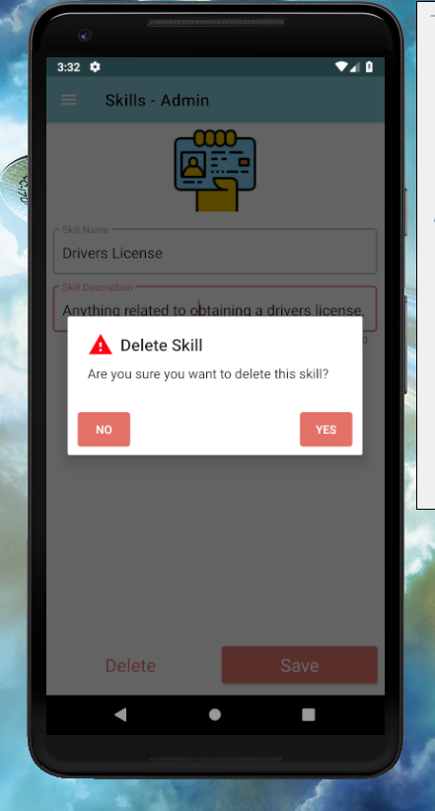
Admin tools*
Add new skills for volunteers to list
Deletion is supported
Corner cases where request tagged to a deleted skill, will not break the app
Items marked with an * are experimental
Items marked in red are in development

Slide 12
In-development/Future
Functional items
Administrative support options
Better filters and prioritization of feed, based on skillset of users, in addition to region
Language support
App settings/personalization
Friends – contacts of known people
UI/UX items
Icons
Background
Coherent design between iOS and Android platform

Slide 13



iOS Team
Bailey Troyer (CSE)
< Open Position >
Web Admin Portal Team
< Open Position >
< Open Position >
< Open Position >
Android Team
Tyler Turnbull (CSE)
Design Team
Hans Bas (CSE)
Brian Balayon (CSE)
Monica Mourad (Graphic Design)
Eli Powers (Graphic Design)

Slide 14
Interested in joining the team? Talk to us now or send an email to the project managers…
Debanjan Paul (dbpaul7@buffalo.edu)
Prachi Patel (ppatil3@buffalo.edu)
…or project organizer…
Dr. Andrew Olewnik (olewnik@buffalo.edu)

